Slide 1
Addison Airport (ADS) Runway Incursion Risk Areas
Pilots: pay close attention to hold line locations and ATC instructions!
Runway 15-33 and Taxiway Alpha have less than the FAA standard (400-ft.) separation
Holding positions east of Rwy 15-33 were moved in late 2002 to comply with current FAA standards; they are unusually close to Twy Alpha!
Pilots holding short of Rwy 15-33 must maintain awareness of the proximity of the mandatory hold position line…this has been the site of several Pilot Deviations over the past few years!
Runway 15
DO NOT cross hold lines without ATC clearance!!
Juliet
300 ft.
250 ft.
Alpha
Alpha
Holding positions very close to Taxiway Alpha

Slide 2
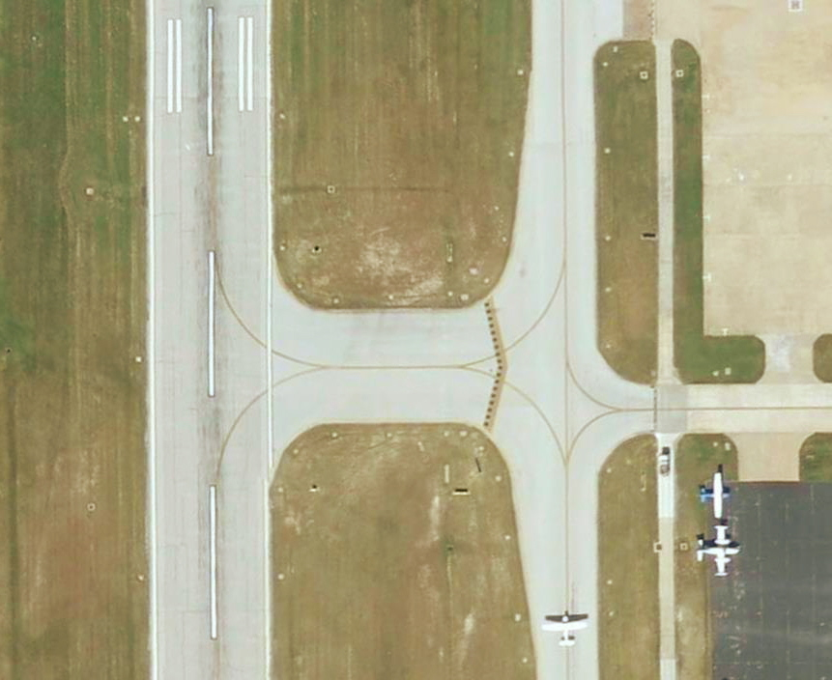
Addison Airport (ADS) Runway Incursion Risk Areas
Pilots: pay close attention to hold line locations and ATC instructions!
Runway 15-33 and Taxiway Alpha have less than the FAA standard (400-ft.) separation
Holding positions east of Rwy 15-33 are unusually close to Twy Alpha
Aircraft holding short of Rwy 15-33 may block traffic on Twy Alpha; this is OK, ADS Ground is aware of the situation and compensates for it
Aircraft clearing Rwy 15-33 must taxi past the hold lines onto Twy A unless otherwise instructed by ATC
300 feet
vehicle service roadway
250 feet
Rwy 15-33
Twy Alpha
hold line

